Slide 1
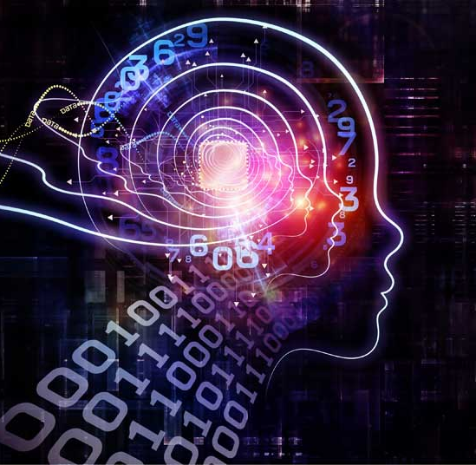
Introduction of Artificial Intelligence
Data is new oil & AI is new IC engine
Dr. Sandip Kumar Lahiri

Slide 2
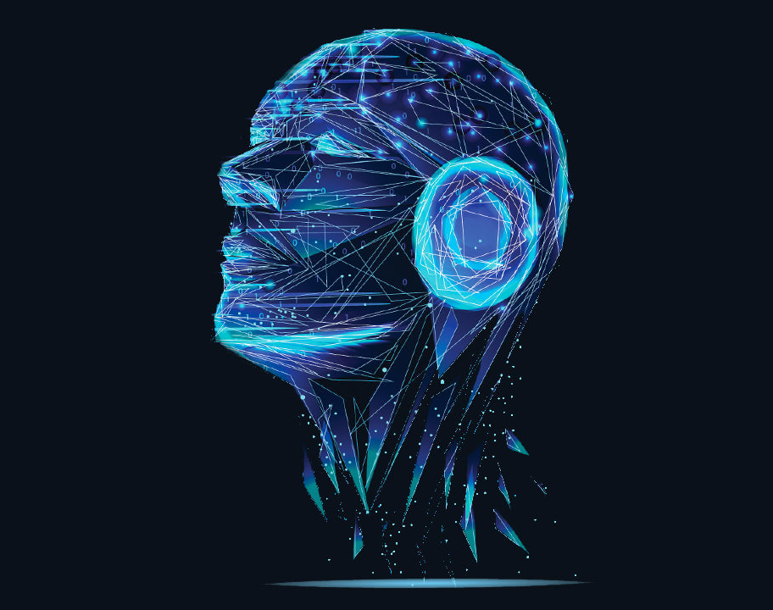
Agenda
What is Artificial Intelligence?
History of Artificial intelligence
Application area of AI
Different Type of AI
AI vs. Machine learning vs Deep Learning
What is Machine learning?
What is Deep Learning?

Slide 3
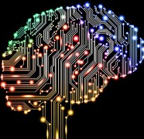
What exactly artificial intelligence is?
The term artificial intelligence was first coined in the year 1956 by John McCarthy at the Dartmouth Conference.
John McCarthy defined AI as
“The science and engineering of making intelligent machines.”
This Photo by Unknown author is licensed under CC BY-NC.

Slide 4
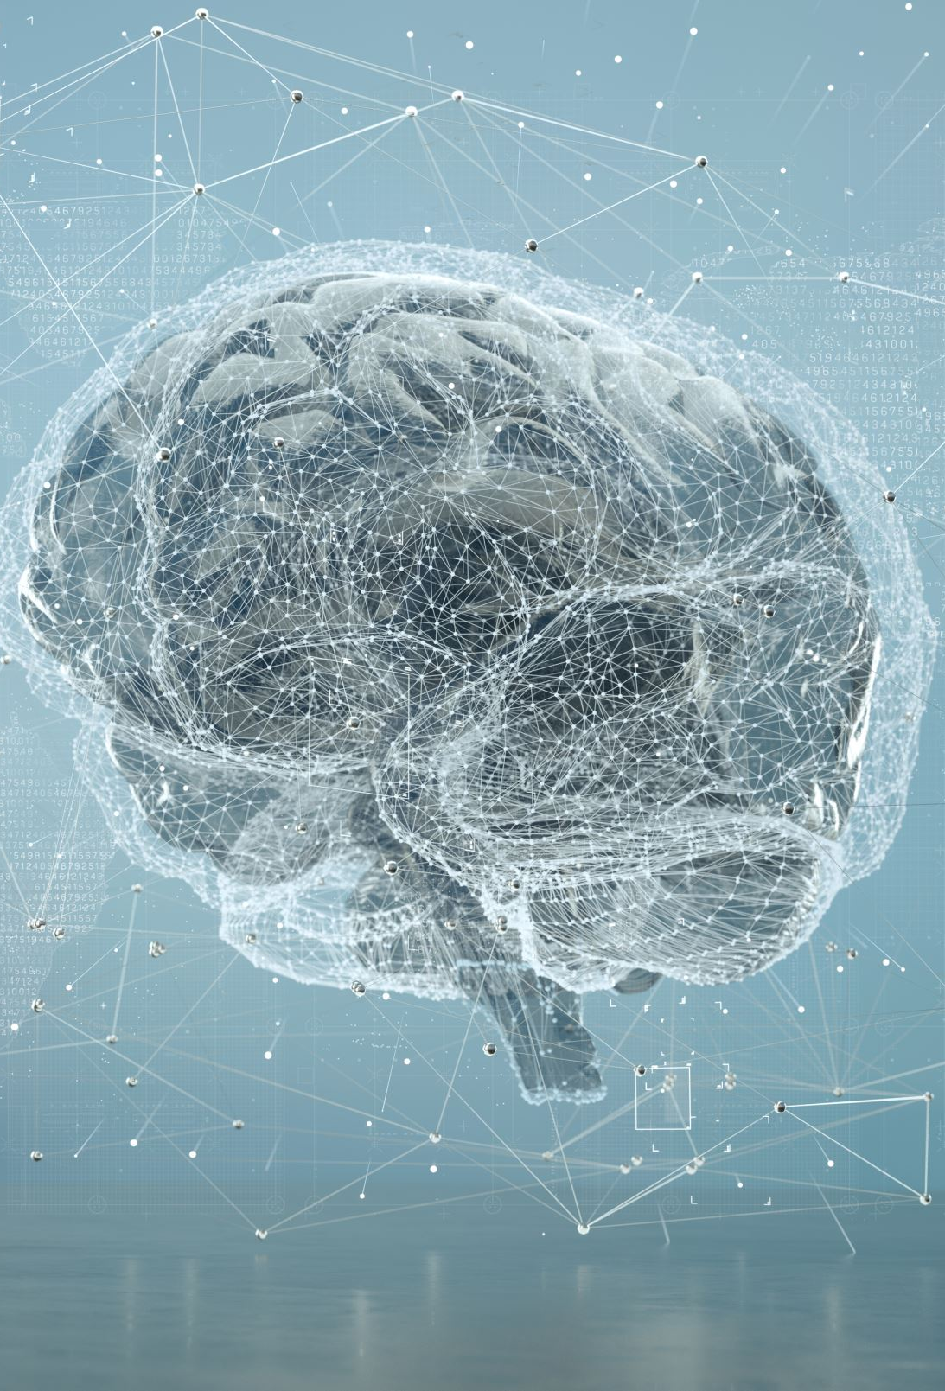
What exactly artificial intelligence is?
Artificial intelligence is the theory and development of computer systems able to perform task that normally require human intelligence, such as visual perception, speech recognition, decision making, and translation between languages.
AI is a technique of getting machines to work and behave like humans.

Slide 5
History of Artificial Intelligence
1950
Alan Turing published a paper in which he speculated about the possibility of creating machines that think. So he created what is known as the Turing test.
1951
By using the Ferranti Mark 1 machine of the University of Manchester, a computer scientist known as Christopher Strachey wrote a checkers program. And at the same time, a program was written for chess as well.
1956
The term artificial intelligence was coined by John McCarthy at the Dartmouth Conference in 1956.

Slide 6
History of Artificial Intelligence
1959
The first AI laboratory was established. This period marked the research era for AI. So the first AI lab where research was performed is the MIT lab, which is still running til date.
1960
The first robot was introduced to the General Motors assembly line.
1961
the first chatbot was invented.
1997
Famous IBM Deep Blue. In 1997, the news broke down that IBM's Deep Blue beats the world champion, Garry Kasparov, in the game of chess. So this was kind of the first accomplishment of AI.

Slide 7
History of Artificial Intelligence
2005
When the DARPA Grand Challenge was held, a robotic car named Stanley, which was built by Stanford's racing team, won the DARPA Grand Challenge. That was another big accomplish of AI.
2011
IBM's question answering system, Watson, defeated the two greatest Jeopardy champions, Brad Rutter and Ken Jennings.

Slide 8
Domains of AI
machine learning,
deep learning,
neural networks,
natural language processing,
knowledge based expert systems
computer vision
image processing.

Slide 9
Why are we talking about artificial intelligence now?
More computation power : one of the greatest technology that made this possible are GPUs
Lot of data at present
Very effective algorithms
Fresh Investment: Universities, governments, startup, and tech giants are all investing in AI.

Slide 10
Major Application area of AI
healthcare,
robotics,
marketing,
business analytics,

Slide 11

Google predictive search engine
Predictive searches are based on data that Google collects about you, such as your browser history, your location, your age, and other personal details.
So by using artificial intelligence, Google attempts to guess what you might be trying to find.
This Photo by Unknown author is licensed under CC BY-SA.

Slide 12
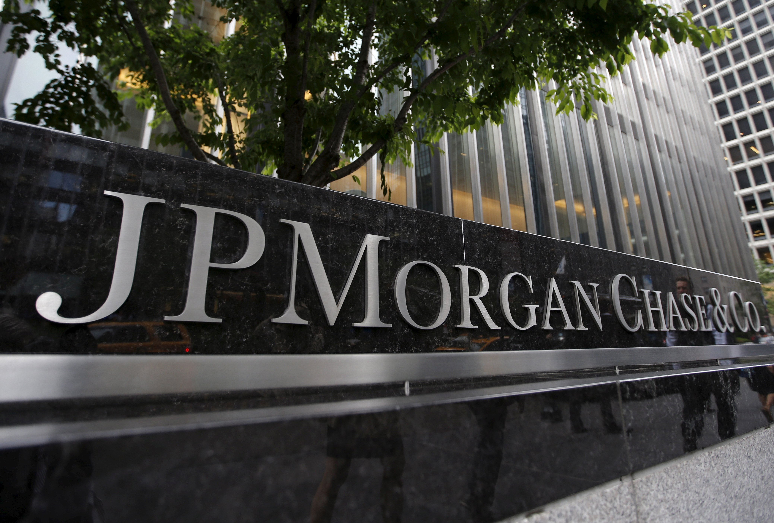
AI in the finance sector
JP Morgan Chase's Contract Intelligence Platform uses machine learning, artificial intelligence,and image recognition software to analyze legal documents.
Manually reviewing around 12,000 agreements took over 36,000 hours.
But as soon as this task was replaced by AI machine, it was able to do this in a matter of seconds.
This Photo by Unknown author is licensed under CC BY-ND.

Slide 13
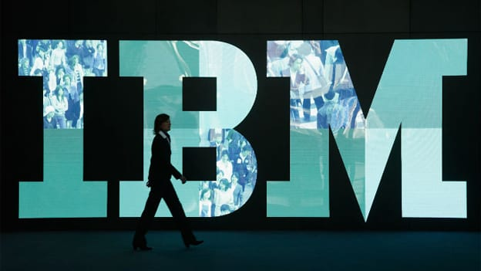
AI in healthcare
IBM is one of the pioneers that has developed AI software, specifically for medicine. more than 230 healthcare organizations use IBM AI technology, which is basically IBM Watson.
In 2016, IBM Watson technology was able to cross reference 20 million oncology records quickly and correctly diagnose a rare leukemia condition in a patient.
This Photo by Unknown author is licensed under CC BY-SA-NC.

Slide 14
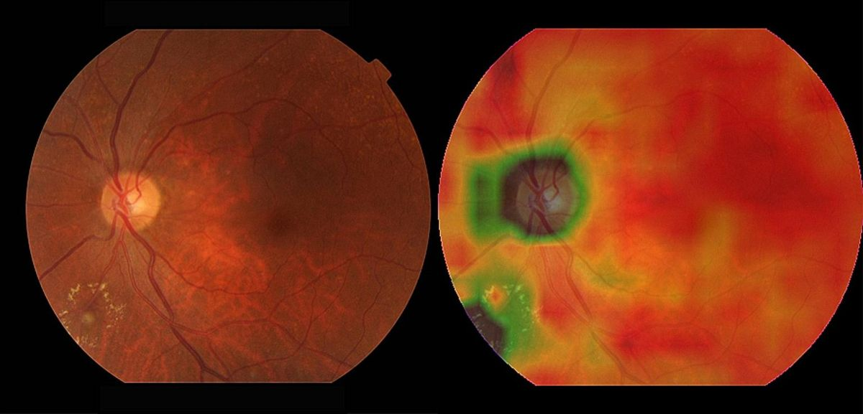
Google's AI Eye Doctor
Google is working with an Indian eye care chain to develop artificial intelligence system which can examine retinal scans and identify a condition called diabetic retinopathy which can cause blindness.
This Photo by Unknown author is licensed under CC BY-NC.

Slide 15

Facebook
artificial intelligence is used for face verification wherein you make use of machine learning and deep learning concept in order to detect facial features and tag your friends.
This Photo by Unknown author is licensed under CC BY-NC.

Slide 16
Social media platforms
Instagram, Facebook, Twitter, they heavily rely on artificial intelligence.
Twitter's AI which is being used to identify any sort of hate speech and terroristic languages in tweets.

Slide 17
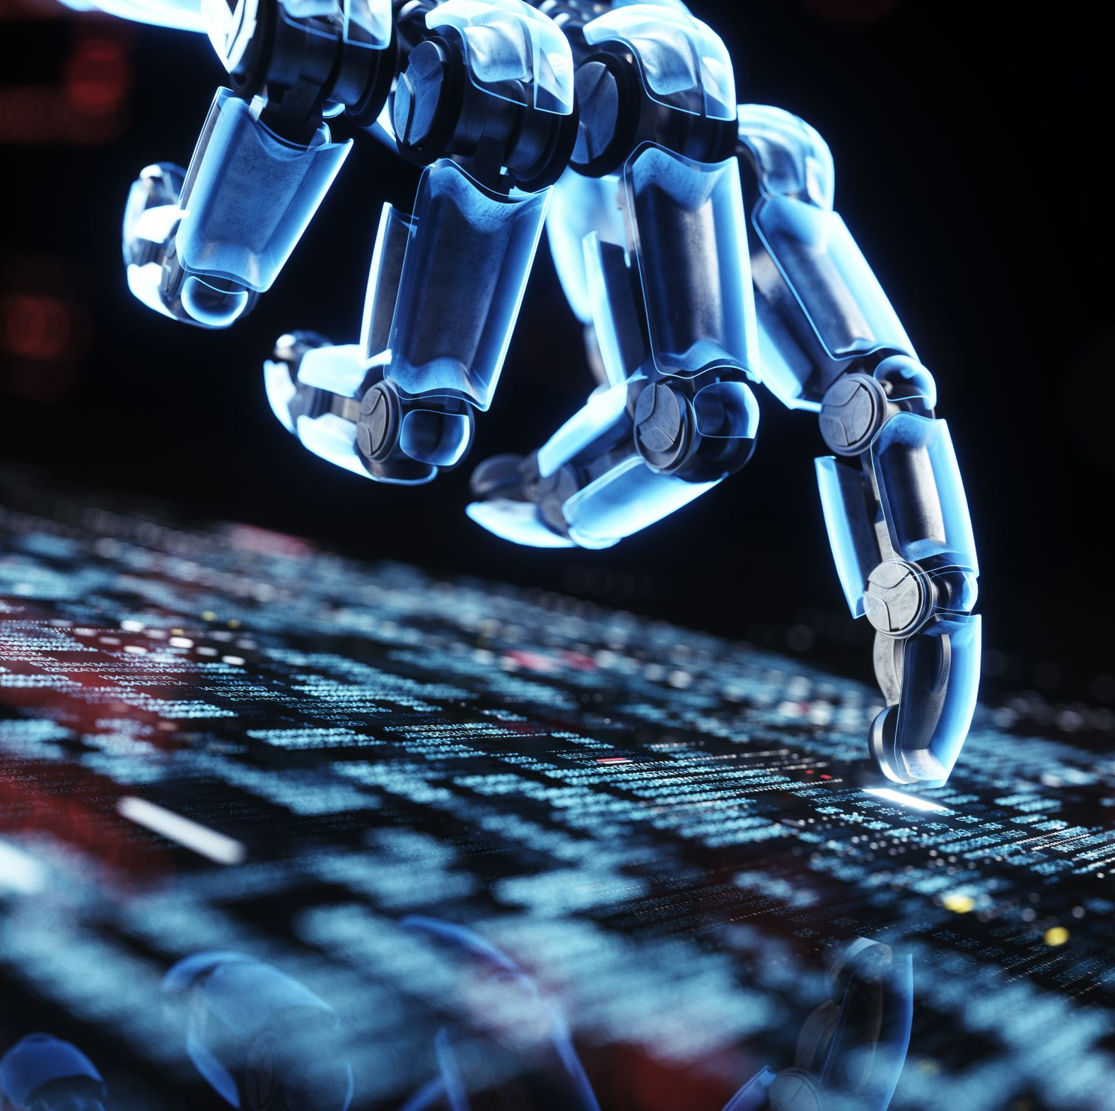
Social media platforms
It makes use of machine leaning, deep learning, natural language processing in order to filter out any offensive or any reportable content.
Now recently, the company discovered around 300,000 terroristic link accounts and 95% of these were found by non-human artificially intelligent machines.

Slide 18
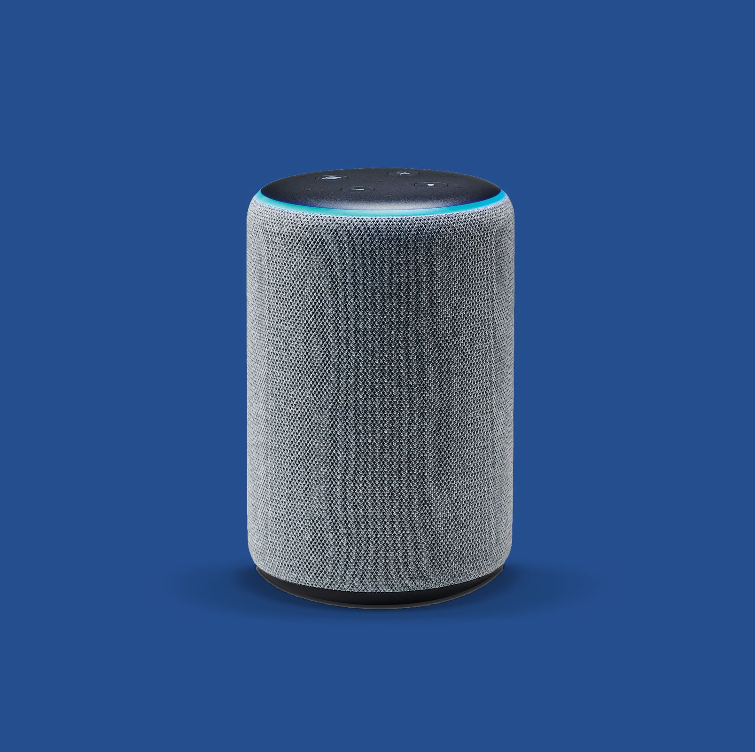
virtual assistants
Virtual assistants like Siri and Alexa right now.
Newly released Google's virtual assistant called the Google Duplex, which has astonished millions of people around the world.
This Photo by Unknown author is licensed under CC BY-SA.

Slide 19
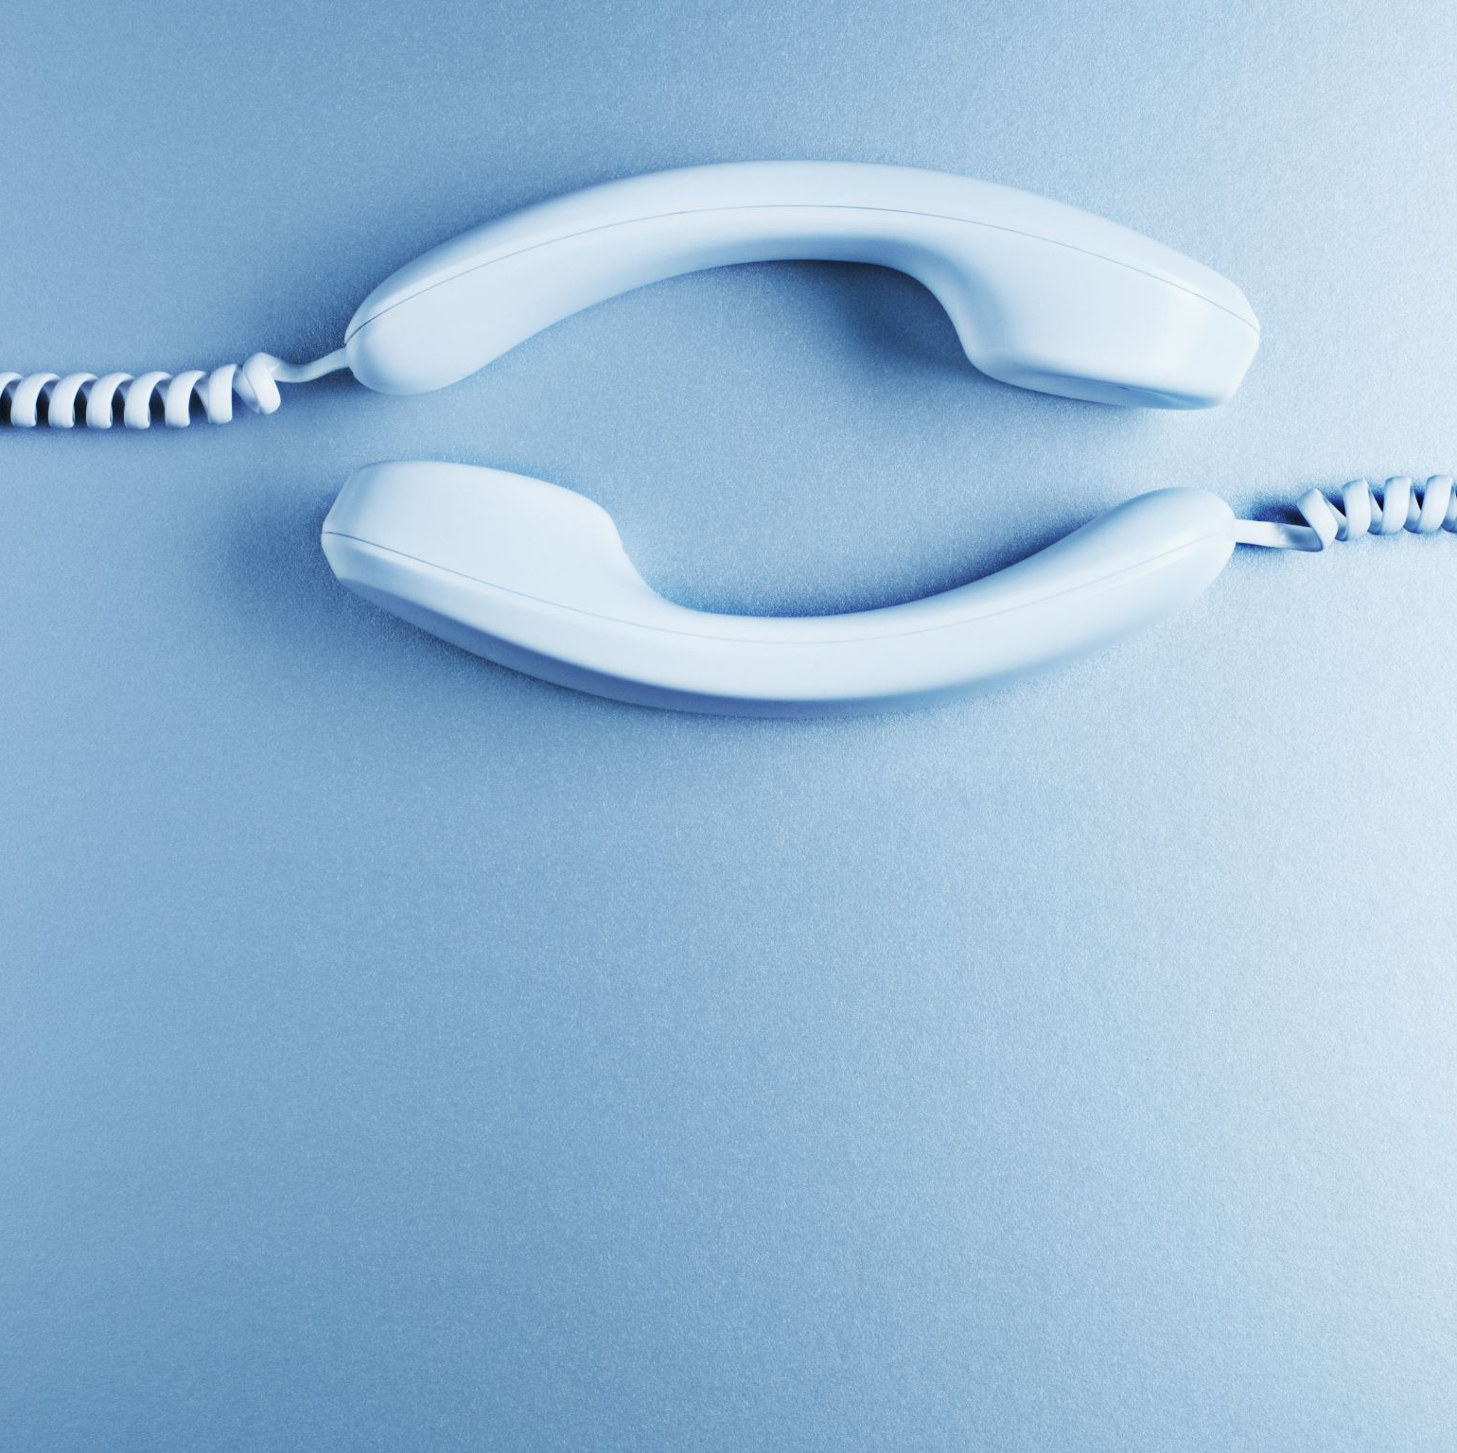
virtual assistants
Not only can it respond to calls and book appointments for you, it also adds a human touch.
So it adds human filters and all of that. It makes it sound very realistic.
It's actually very hard to distinguish between human and the AI speaking over the phone.

Slide 20
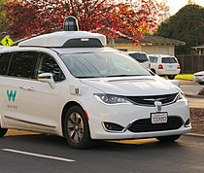
Self-driving cars.
Artificial intelligence implements computer vision, image detection, deep learning, in order to build cars that can automatically detect any objects or any obstacles and drive around without human intervention.
So these are fully automated self-driving cars.
This Photo by Unknown author is licensed under CC BY-SA.

Slide 21
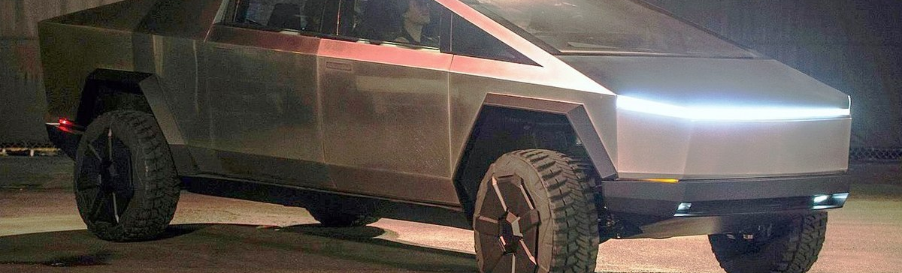
Self-driving cars.
Elon Musk told that Tesla will have fully self-driving cars ready by the end of the year, and robo taxi version that can ferry passengers without anyone behind the wheel.
This Photo by Unknown author is licensed under CC BY-SA.

Slide 22

Netflix
With the help of artificial intelligence and machine learning, Netflix has developed a personalized movie recommendation for each of its users.
So if each of you opened up Netflix and if you look at the type of movies that are recommended to you, they are different.
This Photo by Unknown author is licensed under CC BY-NC-ND.

Slide 23
Gmail
If you open up your inbox right now, you will notice that there are separate sections.
For example, we have primary section, social section, and all of that.
Gmail has a separate section called the spam mails also.
So, what Gmail does is it makes use of concepts of artificial intelligence and machine learning algorithms to classify emails as spam and non-spam.

Slide 24
Different types of AI
Artificial narrow intelligence
Artificial general intelligence,
Artificial super intelligence.

Slide 25
Artificial narrow intelligence,
It is also known as weak AI,
it involves applying artificial intelligence only to specific task.
So, many currently existing systems that claim to use artificial intelligence are actually operating as weak AI

Slide 26
Weak AI
Alexa is a very good example of weak AI.
It operates within unlimited pre-defined range of functions.
There's no genuine intelligence or there is no self awareness, despite being a sophisticated example of weak AI.
The Google search engine, Sophia the humanoid, self-driving cars, and even the famous AlphaGo fall under the category of weak AI.

Slide 27
Artificial general intelligence
It is also known as strong AI,
it involves machines that posses the ability to perform any intelligent task that a human being can.
Machines don't posses human-like abilities.

Slide 28

Artificial general intelligence
They have a very strong processing unit that can perform high-level computations, but they're not yet capable of doing the simple and the most reasonable things that a human being can.
If you tell a machine to process like a million documents, it'll probably do that in a matter of 10 seconds, or a minute, or even 10 minutes.

Slide 29
Artificial general intelligence
But if you ask a machine to walk up to your living room and switch on the TV, a machine will take forever to learn that, because machines don't have the reasonable way of thinking.
They have a very strong processing unit, but they're not yet capable of thinking and reasoning like a human being.
So that's exactly why we're still stuck on artificial narrow intelligence.
So far we haven't developed any machine that can fully be called strong AI,

Slide 30

artificial super intelligence.
Now this is a term referring to the time when the capabilities of a computer will surpass that of a human being.
In all actuality, I'll take a while for us to achieve artificial super intelligence.
Presently, it's seen as a hypothetical situation as depicted in movies and any science fiction books wherein machines have taken over the world, movies like Terminator and all of that depict artificial super intelligence.

Slide 31
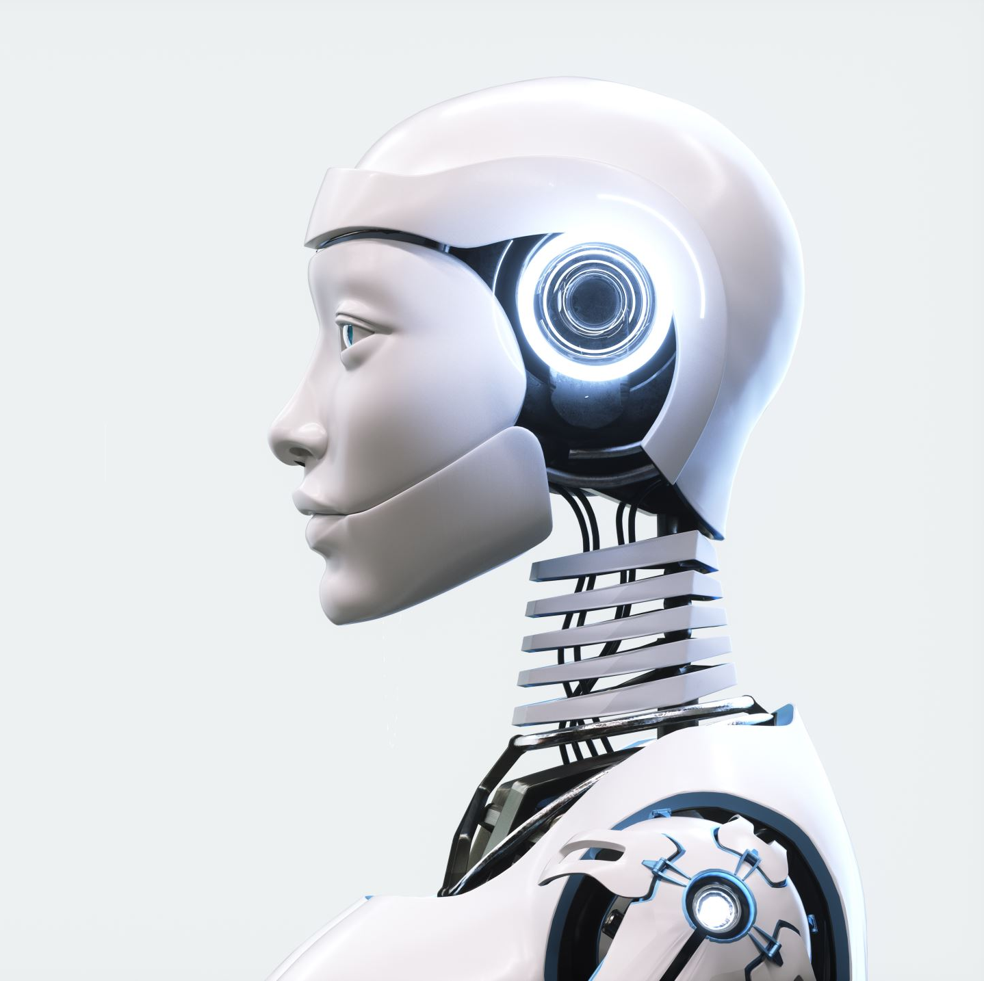
Artificial super intelligence.
These don't exist yet, which we should be thankful for, but there are a lot of people who speculate that artificial super intelligence will take over the world by the year 2040.

Slide 32
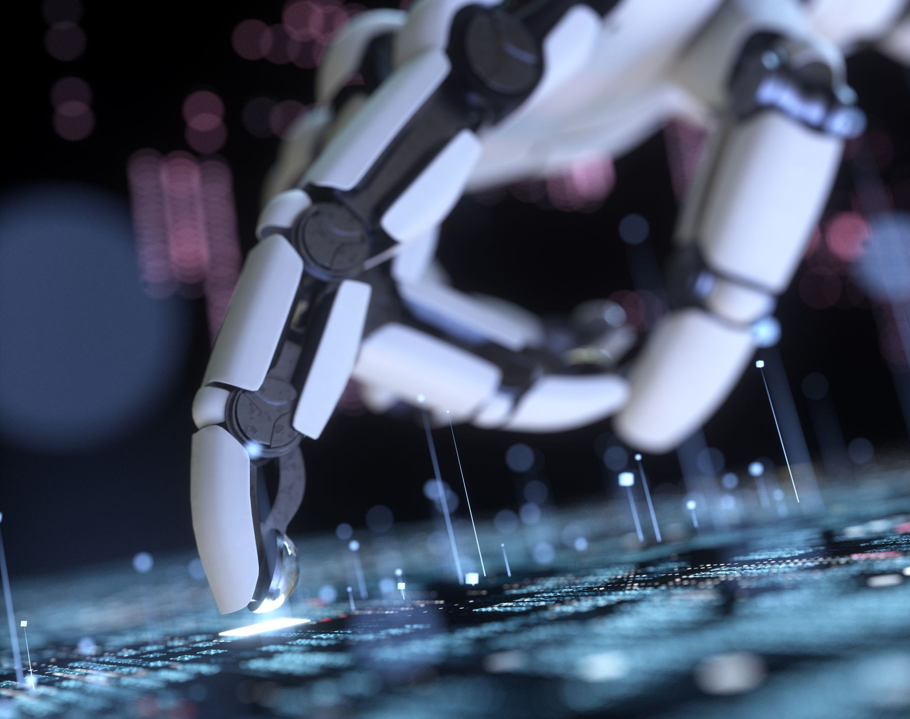
AI vs Machine learning vs Deep Learning
Biggest Confusion

Slide 33
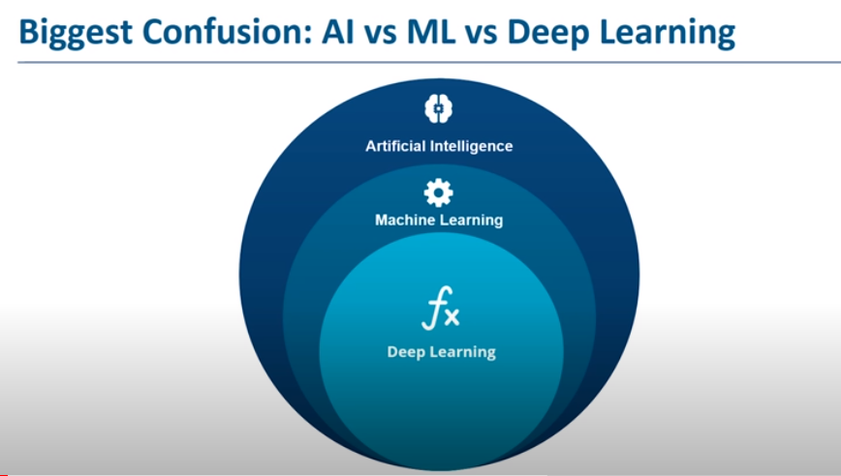

Slide 34

AI vs Machine learning vs Deep Learning
Biggest Confusion

Slide 35
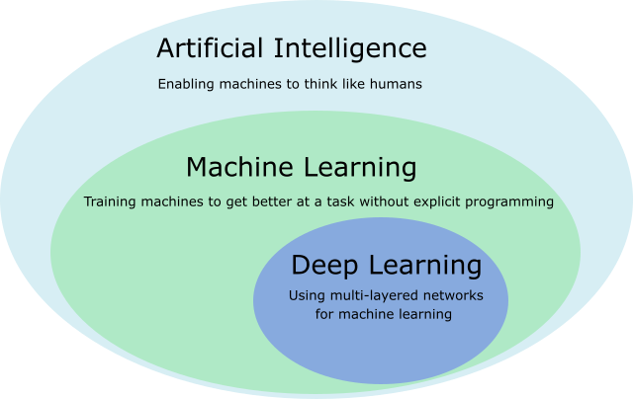
This Photo by Unknown author is licensed under CC BY.

Slide 36
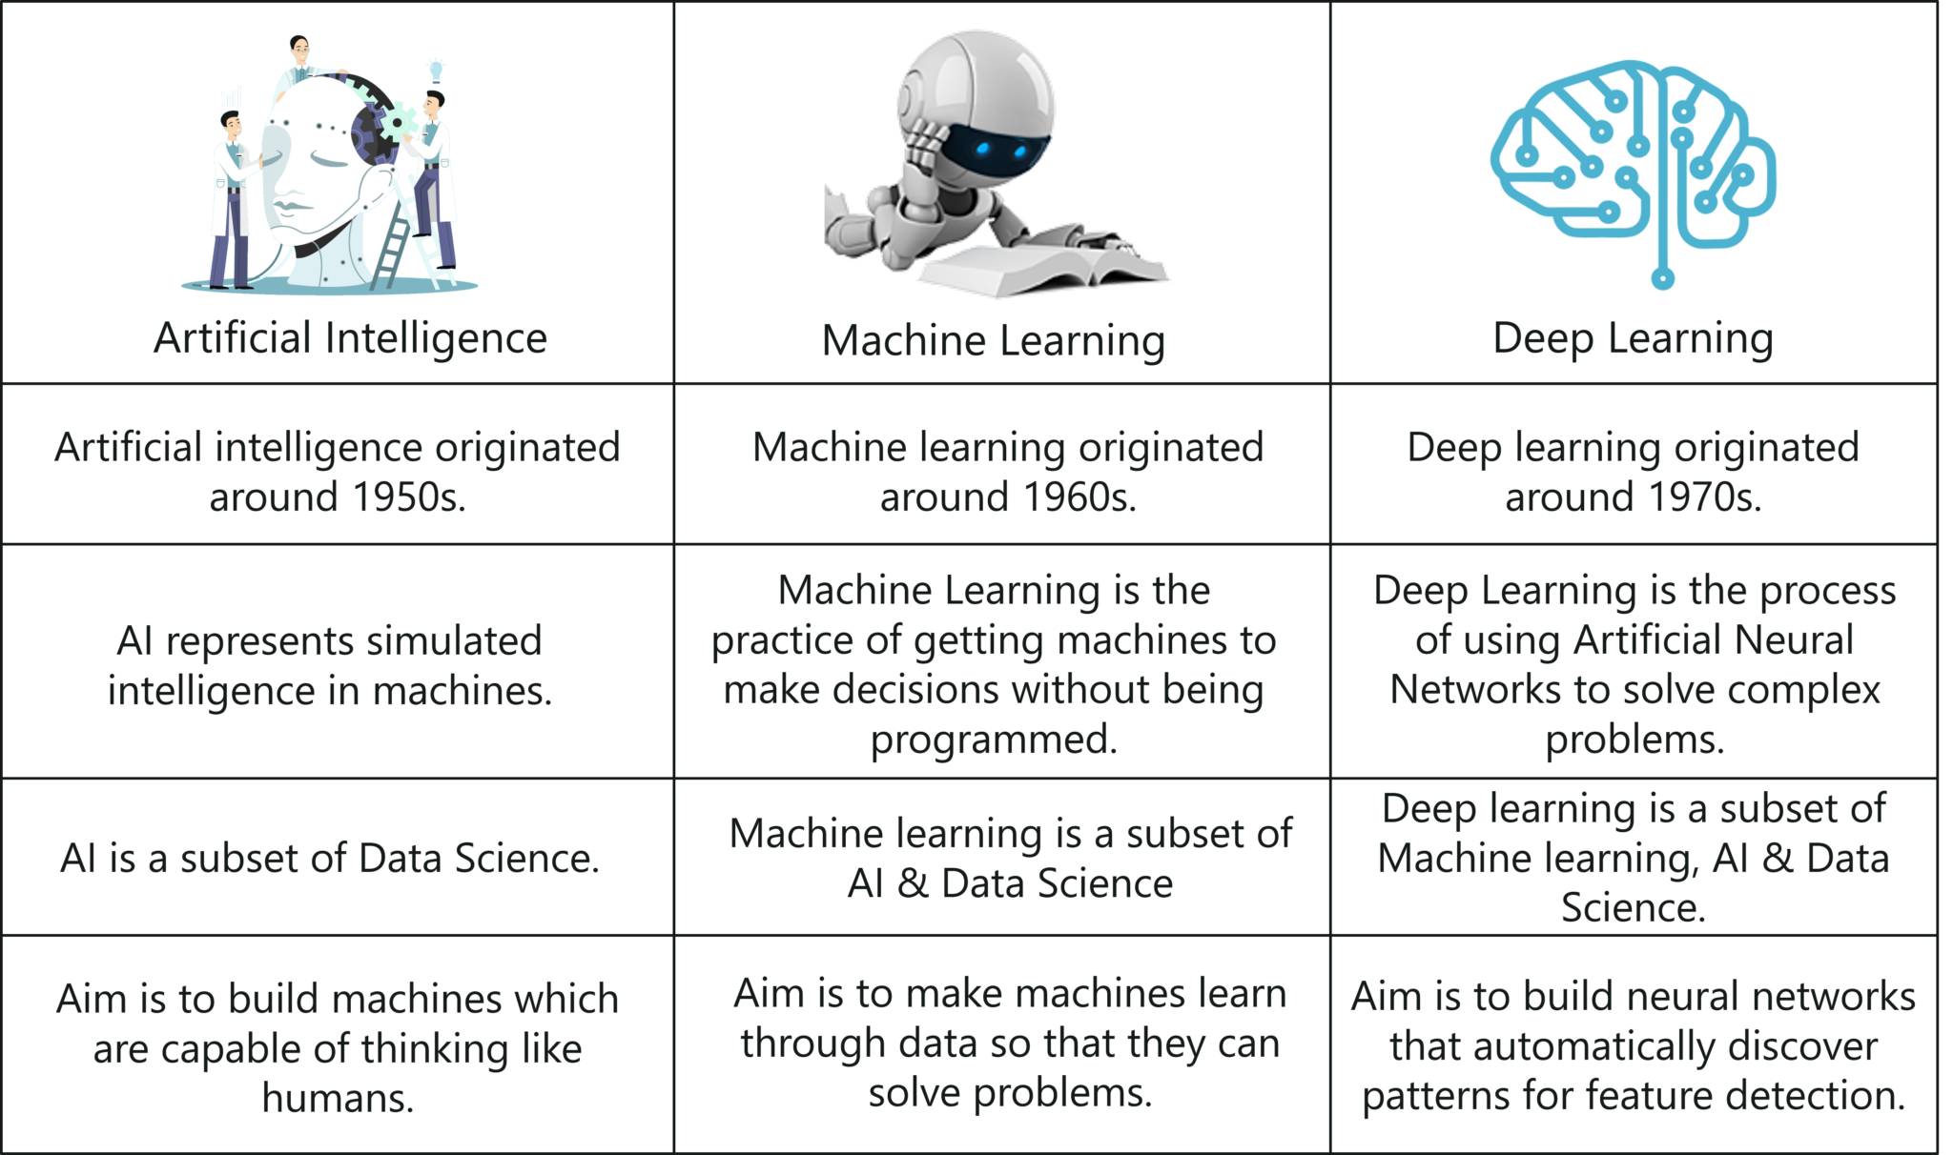

Slide 37
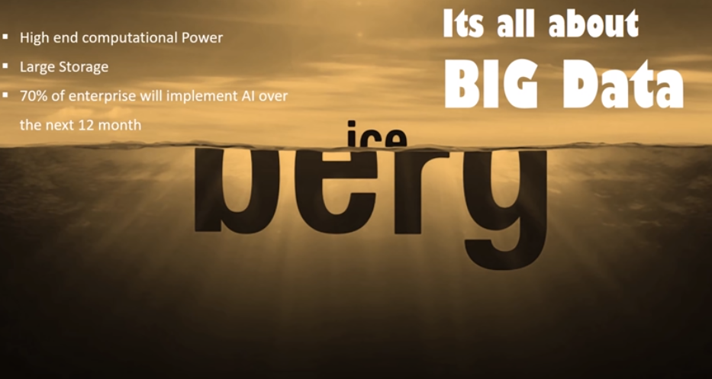

Slide 38
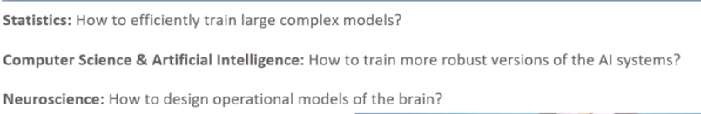
Why Machine learning is introduced?

Slide 39
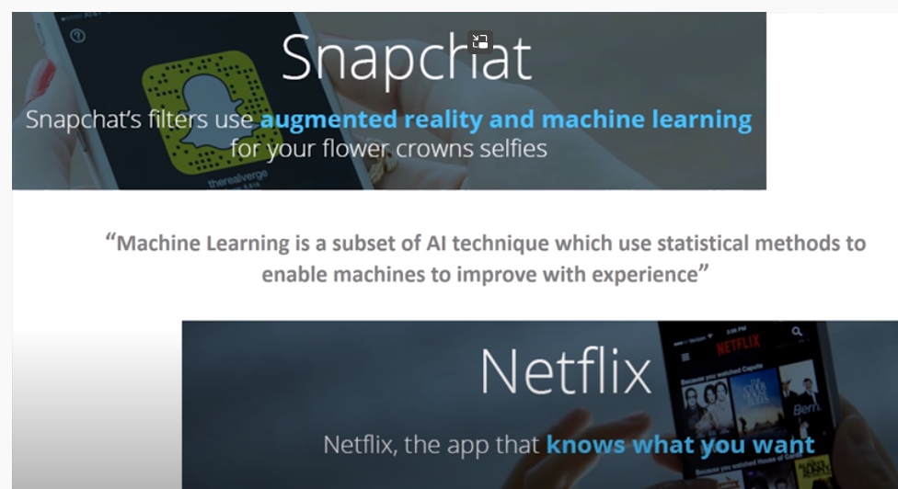

Slide 40
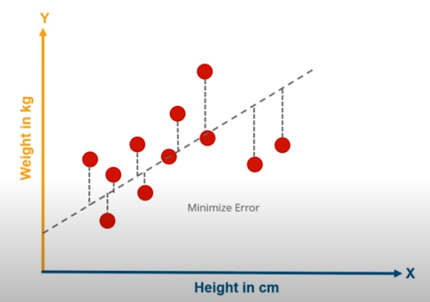
Example of Machine Learning

Slide 41
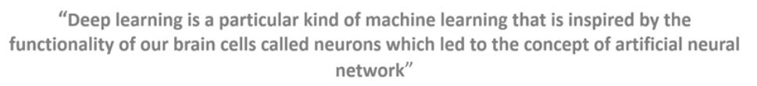
What is Deep Learning ?

Slide 42
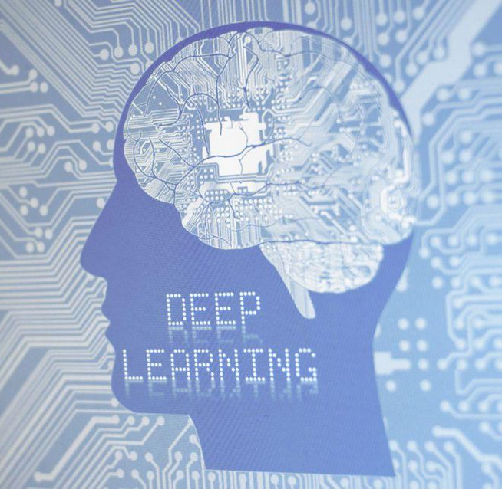
Deep Learning is a Machine learning
This Photo by Unknown author is licensed under CC BY.

Slide 43

Example of Deep Learning?

Slide 44
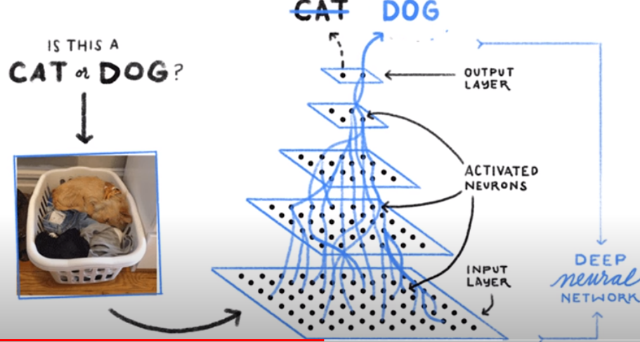
Example of deep learning

Slide 45
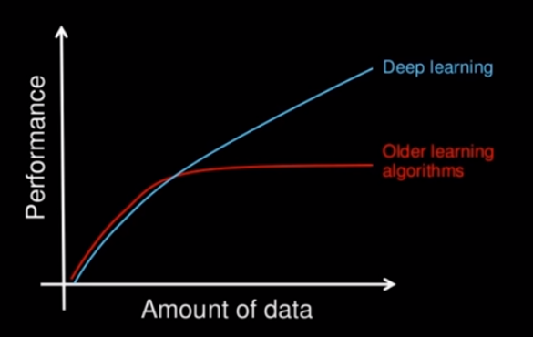
Machine learning vs Deep Learning

Slide 46
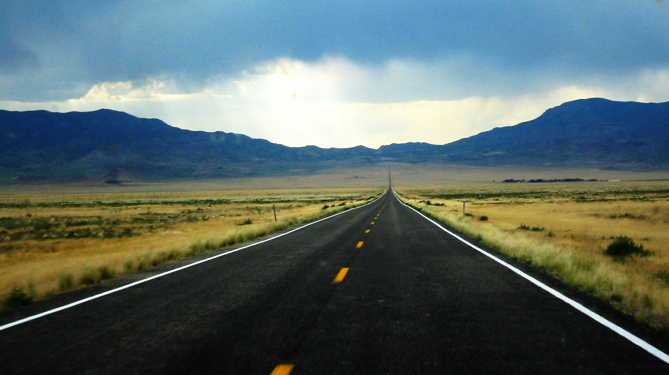
Journey begins
Thanks and Enjoy
This Photo by Unknown author is licensed under CC BY-NC-ND.

